Slide 1
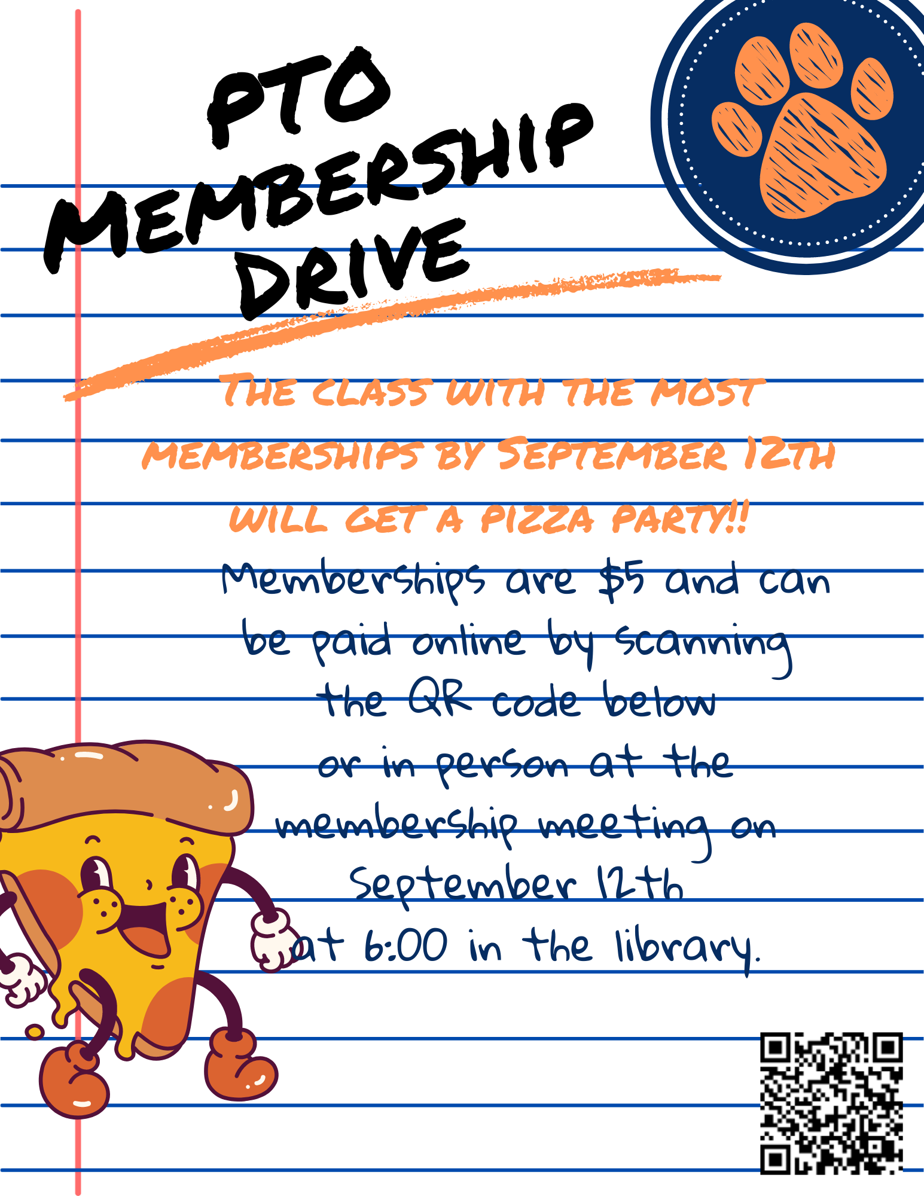

Slide 2
2023-2024 Annual Title I & Family Engagement Meeting
East Knox County Elem. School
August 22 and August 24
6:00 pm in the gym
Kristi Woods, Principal
Cyndee Casselman, Assistant Principal

Slide 3
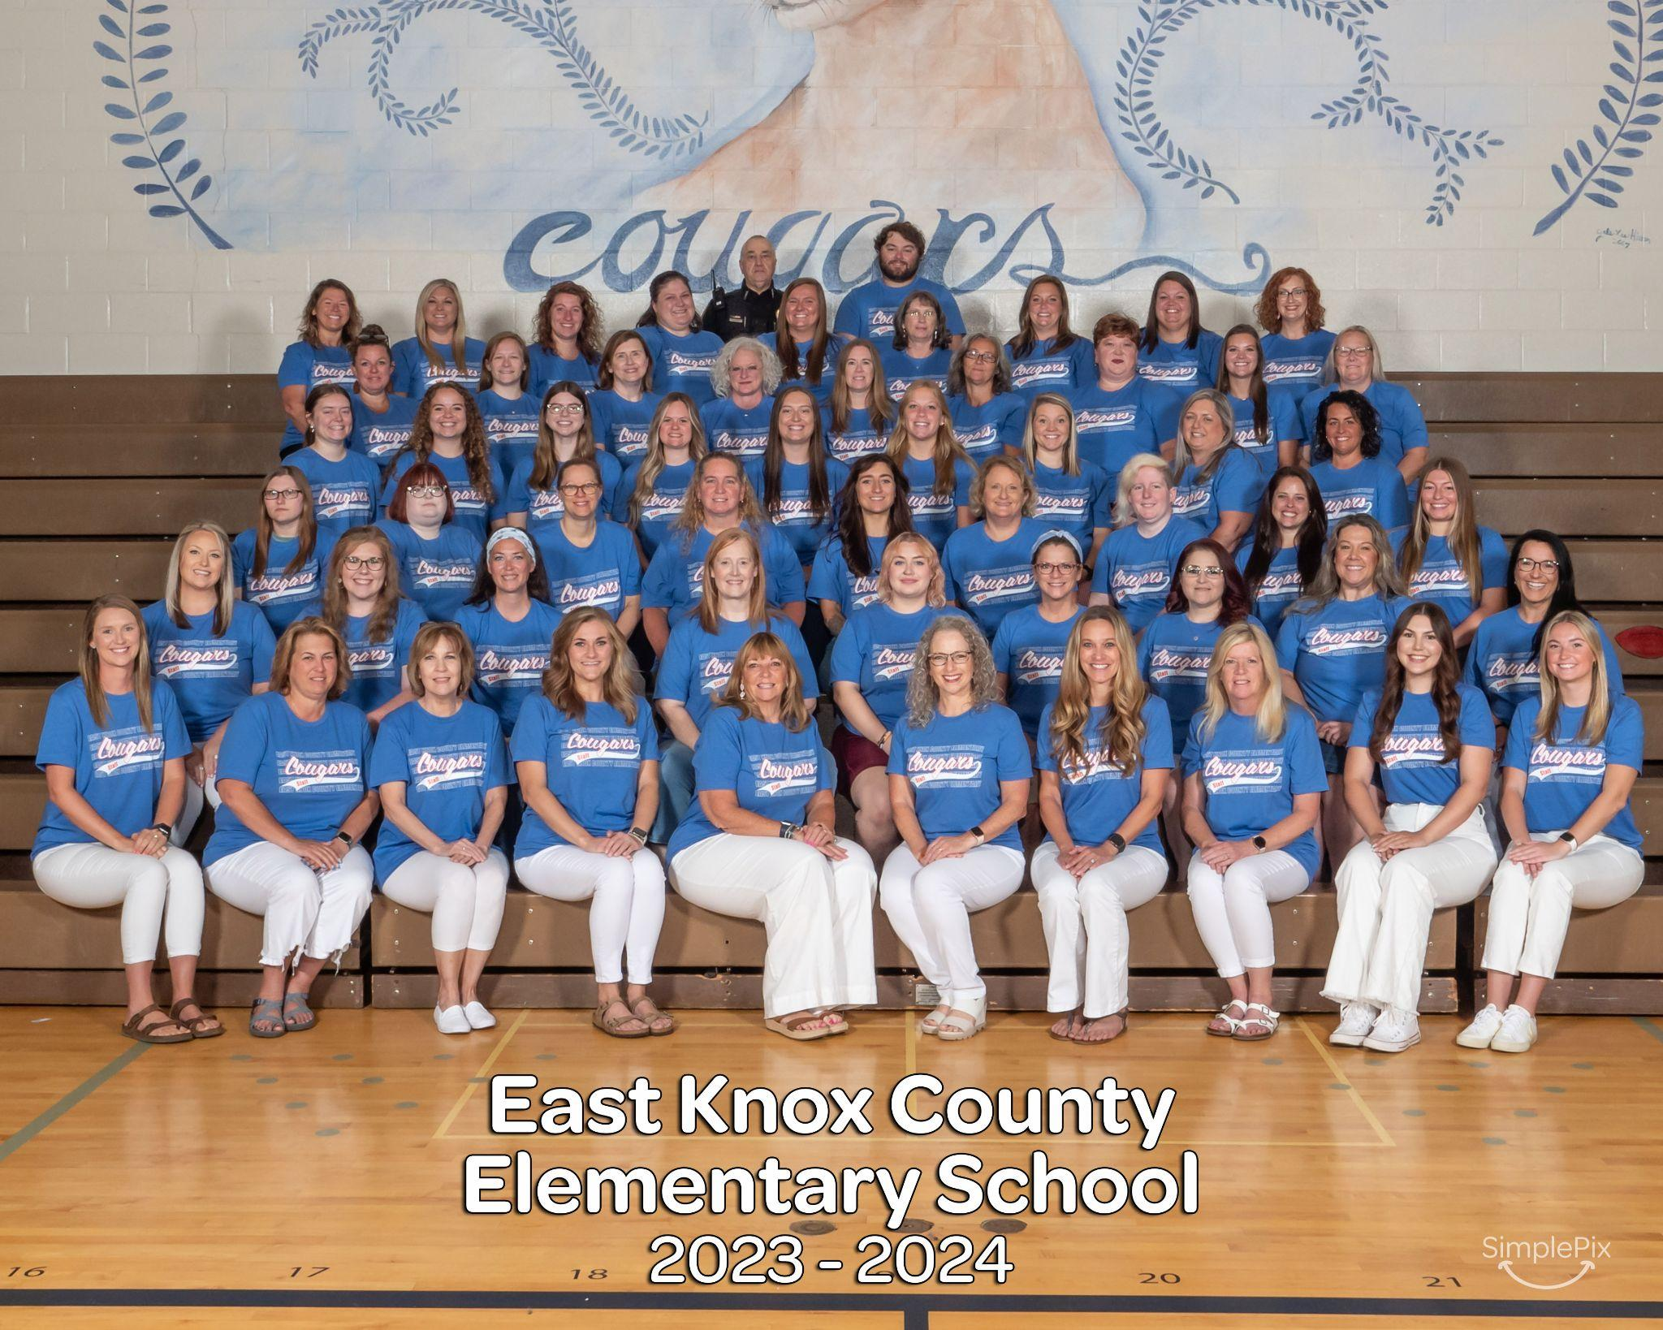
East Knox Staff WELCOMES our EAST KNOX FAMILIES!

Slide 4
Why are we here?
The Every Student Succeeds Act (ESSA) requires that each Title I school hold an annual meeting of Title I families in order to:
Inform you of your school’s participation in Title I.
Explain the requirements of Title I.
Explain your rights as parents and family members to be involved.

Slide 5
What will I learn?
What is a Title I school?
What are my rights?
What can Title I funds be used for?
How does our school use Title I funds?
What is the School Plan?
What are our school goals?
What is our schoolwide student support system? (Behavior Coach)
Why attendance is important? (Assistant Principal)
How do I protect my child’s assigned device?
How is parent and family engagement funded?
What is the Parent and Family Engagement Policy?
What is the School-Parent Compact?
How can I participate in a parent collaboration session?
What curriculum does our school use?
What tests will my child be taking?
How can I be involved?
Who can I see for more information about PTO?

Slide 6
What is a Title I school?
Title I was passed in 1965 under the Elementary and Secondary Education Act (ESEA). It is the largest federal assistance program for our nation’s schools.
Title I schools receive extra funding (Title I dollars) from the federal government. These dollars are used to:
identify students experiencing academic difficulties and provide assistance to help these students
purchase additional staff, programs, materials, and/or supplies
conduct parent and family engagement meetings, trainings, events, and/or activities

Slide 7
What are my rights?
The families and parents of Title I students have a right, by law, to:
Be involved in decisions made at both the school and district level
Be provided with information on your child’s level of achievement on tests in reading/language arts, writing, mathematics, and science
Request and receive information on the qualifications of your child’s teacher and paraprofessionals who are working with your child
Request opportunities for regular meetings to formulate suggestions and to participate, as appropriate, in decisions about the education of your child. The school is required to respond to any such suggestions as soon as practicably possible.

Slide 8
What can Title I funds be used for?
In general, Title I funds may be used for:
smaller class sizes
additional teachers and paraprofessionals
additional training for school staff
extra time for instruction (before and/or after school programs)
parent and family engagement activities
a variety of supplemental teaching materials, equipment, and technology

Slide 9
How does our school use Title I funds?
For 2023-2024, our school was allotted approximately $227,860.00 in Title I
funding.
We developed a Schoolwide Program, which means we plan to spend our funds on the following:
Supplemental staff:
Behavior Coach
Instructional Coach
Educational Assistants
Leader In Me Social/Emotional Curriculum

Slide 10
What is the SIP?
The SIP is the School Improvement Plan. It includes:
the identification of the school planning team and how they will be engaged in the planning process
a needs assessment and summary of academic and non-academic data
prioritized goals, strategies, and action steps to help address the academic and non-academic needs of students
teacher and staff professional development needs
budgets and the coordination of resources
The school must include family representatives on our school planning team.
Please let your child’s principal know (Kristi.woods@Knoxschools.org) if you would like to be on our school planning team.

Slide 11
What are East Knox’s school goals?
Tier 1 English Language Arts: Excellence in Foundational Skills
Tier 1 Math: Excellence in Algebra 1 Foundational Skills
Success for Every Student

Slide 12
Schoolwide Language
Expectations
Safe
Respectful
Responsible
Earning
Notes:
Julie

Slide 13
How it looks in the classroom:
Daily Point Sheet
Throughout the school day, each student has the opportunity to earn points for being Safe, Respectful and Responsible.
Every student has the opportunity to earn 100 daily points.
The point sheet travels to lunch, recess and Encore.
Notes:
Julie

Slide 14
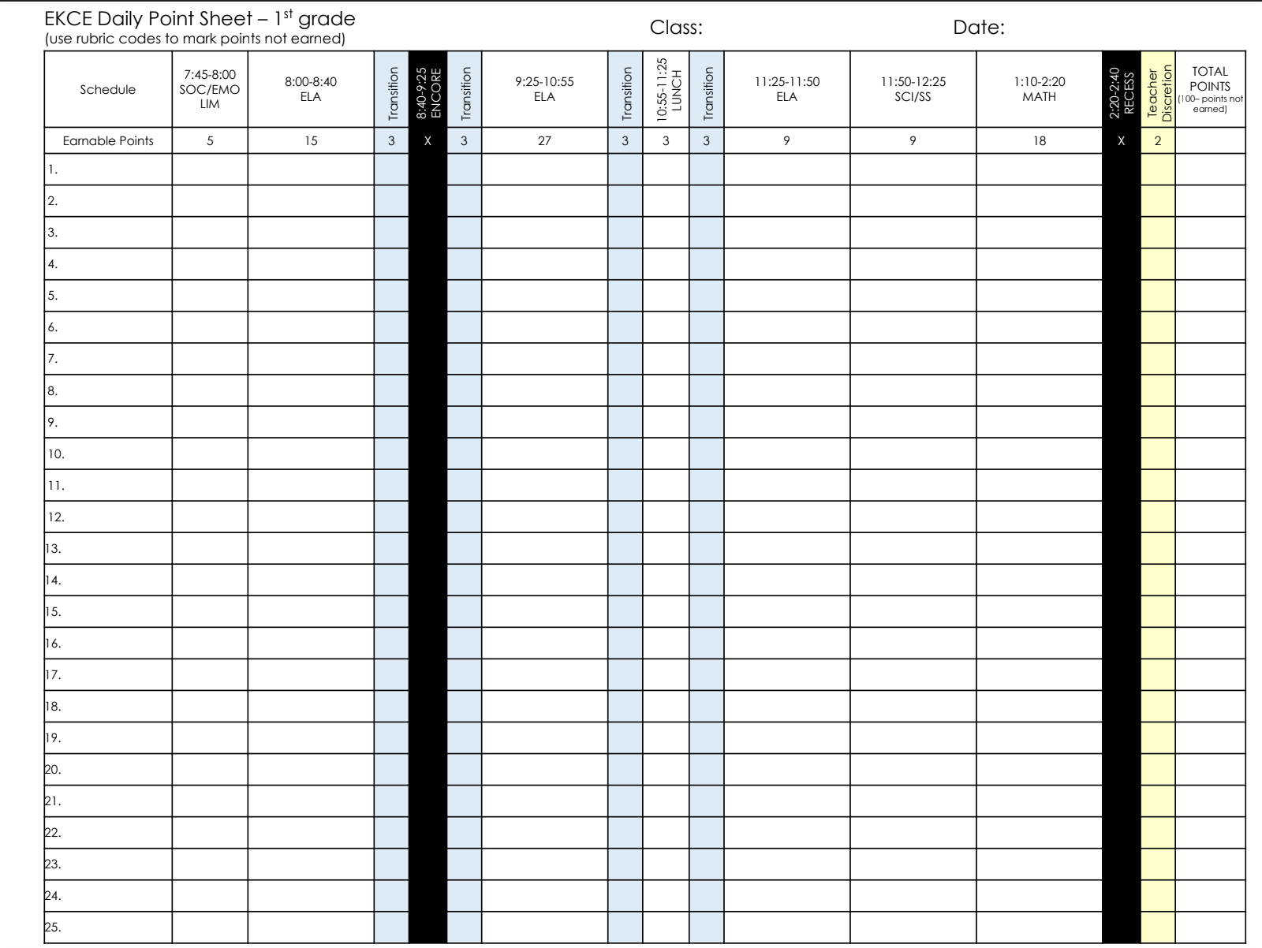
Notes:
Julie

Slide 15
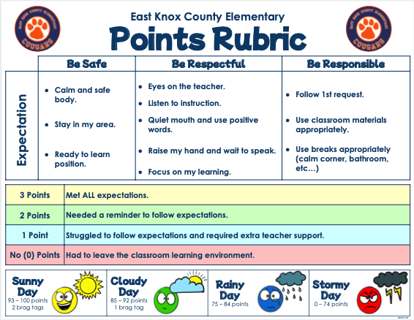
Notes:
Julie

Slide 16
How it looks at home?
Monthly Calendars
Daily/Weekly communication sent home
Student ownership of their earned points for the day
Tomorrow is ALWAYS a new day

Slide 17
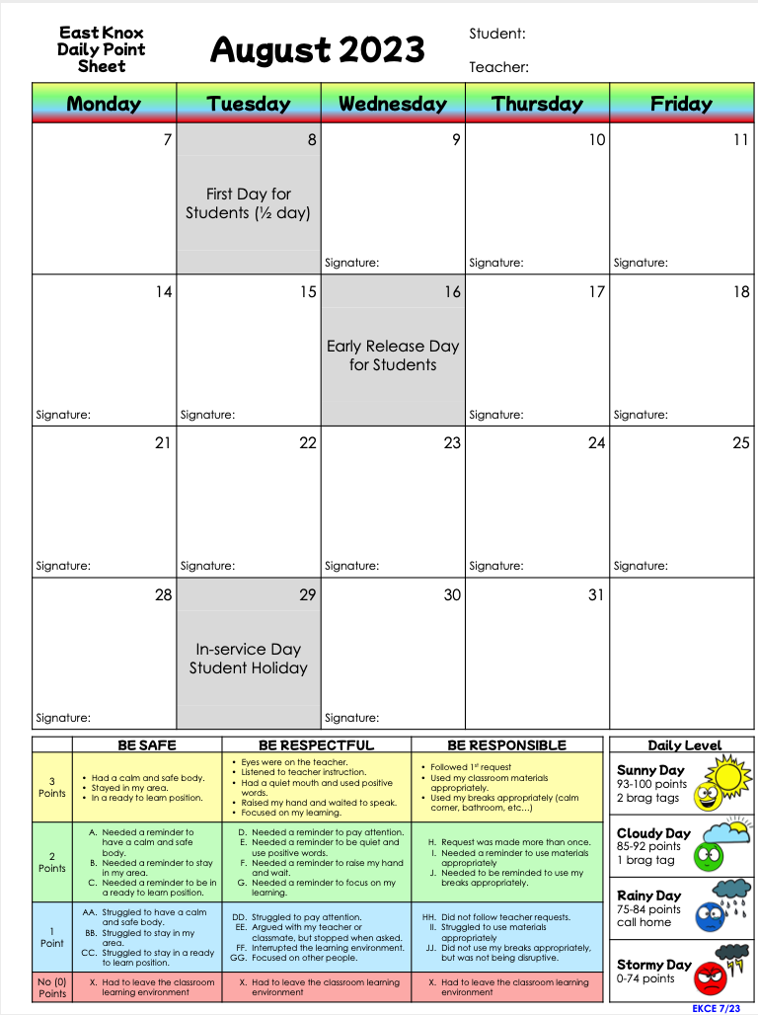
Example Monthly Calendars
Grade 1-3
Notes:
Julie

Slide 18
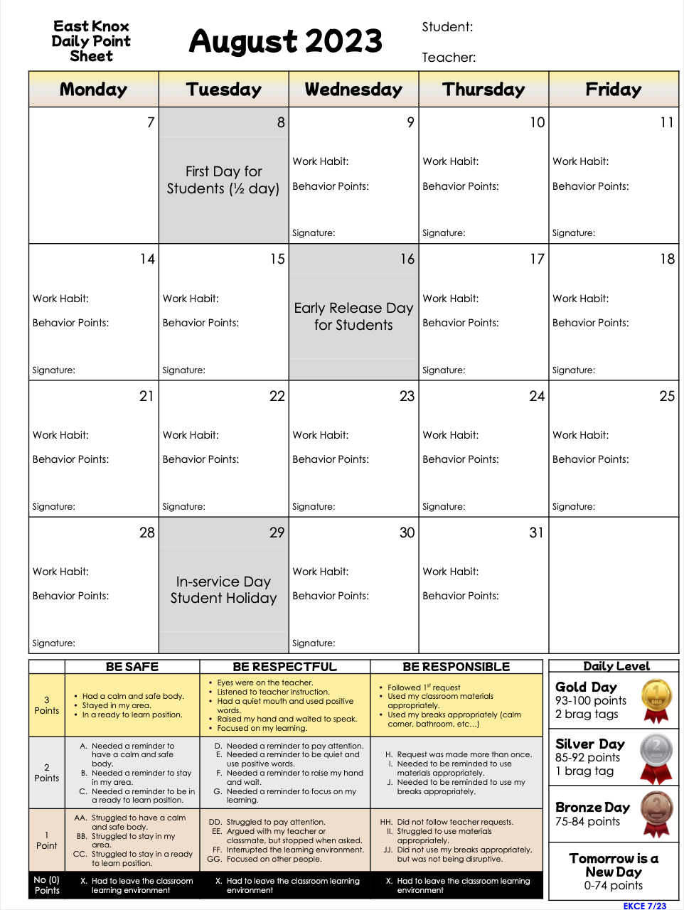
Example Monthly Calendars
Grade 4-5
Notes:
Julie

Slide 19
What do all these points mean?
Establishing consistency across the school.
Reinforcing positive academic and social/emotional behavior
Opportunity for positive student/teacher interactions
Fosters respectful, supportive relationships
Reinforces positive behaviors
Students learn how to create a SAFE, RESPECTFUL, and RESPONSIBLE environment.
Acknowledge positive student behavior
Notes:
Julie

Slide 20
Celebrations!
Students will have a chance throughout the year to receive Positive Celebrations.
The 4th Celebration results in a Positive Office Referral.
Students will choose an item from our Cougar Swag Basket and we will call home:)
Notes:
Julie

Slide 21
We Teach Everyone Here!
Reading
Math
Science
Social Studies
Leader in Me Social Emotional Curriculum
Interventions
Art, Music, PE, Library, Counseling
GOAL- We need everyone here to teach them!
Notes:
Cyndee

Slide 22
We Need Everyone Here!
23.2% of students in 2022-23 were chronically absent (missed more than 10% of the school year). This is an improvement from 21-22 School Year of 38.2% chronically absent. .
GOAL- Decrease our chronic absenteeism. Miss less than a week of school.
Notes:
Cyndee

Slide 23
We Want Everyone Here!
School opens at 7:15 a.m.
Breakfast is served and available free for all students.
Opportunity for students to get to their class and be prepared.
Automated messages if child absent.
GOAL- be here and ready to learn by 7:45 a.m.
Here on time award- H.O.T.
Notes:
Cyndee

Slide 24
Device
Devices will Stay at School! - Devices will not be coming home unless there is an extenuating circumstance with absences. Those will be approved by administration and will occur depending upon circumstances.
Device Agreements: If you have not returned your child’s device agreement please do so as soon as possible. If you don’t have one, we can get you one.
Device Insurance: It is highly recommended that you buy insurance to cover incidental damages ($20)
Chargers: Not covered under insurance - $20 fee to replace
Digital Citizenship: Teach your child how to be a good digital citizen while on their device at school. Digital citizenship lessons are being taught to each grade level, and students are signing an agreement that they will follow the expectations.
Notes:
Carmen

Slide 25
Device Insurance is $20 to be paid by September 30, 2023
Accidental Damage: The plan pays for drops, liquid damage, or other unintentional acts of damage to the device. This includes, but is not limited to the screen, keyboard, bezel, ports/buttons, or battery.
Theft: Damage or loss due to theft. The claim requires the student or family to submit a police report.
Fire: Pays for loss or damage due to fire; requires a report from the investigating authority.
Electrical Surge: Pays for damage due to electrical power surges.
Natural disaster: Pays for damage caused by a natural disaster.
Notes:
Carmen

Slide 26
**Device Protection Plan Exclusions**
- Intentional Damage. The protection plan does not pay for damage caused by negligent or intentional acts. Damage determined to be intentional will incur a replacement fee.
- Lost/Damaged Consumables. Power adapter ($20 replacement cost) is not covered under the plan.
- Lost/Missing devices are not covered under the insurance plan ($250 replacement cost).
- Cosmetic Alterations. Any device personalization will be charged for the replacement cost of the damaged part(s). This includes stickers, markings, graffiti, etc.
Notes:
Carmen

Slide 27
Notes:
Carmen

Slide 28
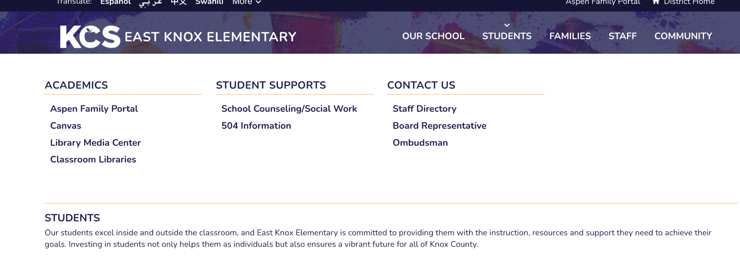
All information on our School Counseling Program are available on our East Knox Website.
Including :
Making a counselor or social worker referral
Other links and resources
Life Skills Class schedule
(ALL lesson are available on CANVAS)
TN standards for a comprehensive developmental school counseling program
Any special announcements
Contact information
Notes:
Patricia

Slide 29
How is parent and family engagement funded?
Any district with a Title I allocation exceeding $500,000 is required by law to set aside 1% of the Title I allocation for parent and family engagement.
Of that 1%, 10% may be reserved at the district for system-wide initiatives related to parent and family engagement. The remaining 90% must be allocated to all Title I schools in the district.
You, as Title I parents and family members, have the right to be involved in how this money is spent.

Slide 30
How is parent and family engagement funded?
In 2023-2024, we received approximately $3586.00 in parent and family engagement funding. We plan to use these funds for:
Parent and Family Engagement Meeting and Events – Family Fun Nights! Please turn in your input as you leave.
Materials/Supplies
Books, Games, manipulatives for FCE Events
Snack for FCE Events

Slide 31
What is a Parent and Family Engagement Policy?
These plans address how the district and school will implement the parent and family engagement requirements of ESSA. Components should include:
how parents and families can be involved in decision-making and activities
how parent and family engagement funds are being used
how information and training will be provided to families
how the school will build capacity in families and staff for strong parent and family engagement
You, as a Title I parent or family member, have the right to be involved in the development of these plans.

Slide 32
What is a Parent and Family Engagement Policy?
The district Parent and Family Engagement Policy (I-270) can be found on the Knox County Schools website -> Our District -> Board of Education -> Board Policies
www.knoxschools.org/Page/2107
The East Knox Parent and Family Engagement Policy is on our schools website -> Families -> Family Information-> Title I Family Plan or Title I Compact
www.knoxschools.org/eastknoxes

Slide 33
What is a School-Parent Compact?
A school-parent compact is a written commitment that outlines how the entire school community – teachers, families, and students will share the responsibility for improved academic achievement.
The East Knox Parent and Family Engagement Policy is on our schools website -> Families -> Family Information-> Title I Family Plan or Title I Compact
www.knoxschools.org/eastknoxes
The compact must describe how the school will:
provide high-quality curriculum and instruction
hold parent-teacher conferences, annually in elementary schools
provide parents with reports on their child’s progress
provide parents reasonable access to staff
provide parents opportunities to volunteer
ensure regular two-way meaningful communication between family members and staff, to the extent practicable, in a language family members can understand
You, as a Title I parent or family member, have the right to be involved in the development of the compact.

Slide 34
Please join us for a family input session
Coffee with the Principals
5:30 p.m. Thursday, Sept. 21, 2023
7:45 a.m. Friday, Sept. 22, 2023
To develop our School Level Family Engagement Plan
To develop our School Compact

Slide 35
What curriculum does our school use?
The Tennessee Academic Standards provide a common set of expectations for what students will know and be able to do at the end of a grade for each subject area.
Tennessee's academic standards form the framework for everything taught at East Knox County Elem. School
For more information about Tennessee’s academic standards, see:
https://www.tn.gov/content/tn/education/instruction/academic-standards.html
Curriculum
TN BENCHMARK ADVANCE (READING LANG.ARTS) BENCHMARK EDUCATION CO
TN READY MATH CURRICULUM ASSOCIATES
(K-2) SOLID Start (SCIENCE Oral Language and Literacy Development from the Start of School)
TN INSPIRE SCIENCE - BE A SCIENTIST NOTEBOOK (3-5) MCGRAW HILL EDUCATION
TN EXPERIENCE - SOCIAL STUDIES (Grades 3-5) GALLOPADE
INTO SOCIAL STUDIES (Grade 2) HOUGHTON MIFFLIN HARCOURT
TN STUDIES WEEKLY (Grade K&1) AMERICAN LEGACY PUBLISHING

Slide 36
What tests will my child be taking?
Universal Screener: Reading and Math – 3 times a year (K-5)
Mastery View Predictive Assessment – 2 times a year (2-5)
TCAPs for 3rd-5th grade (paper)
April 15-30, 2024
Classroom assessments

Slide 37
How can I be involved?
We need you! Research has proven that family engagement in education has more impact on student achievement than any other factor.
Please contact Kristi.woods@Knoxschools.org to get involved with the school improvement plan
To give input on our Parent and Family Engagement Policy, please complete the survey.
To give input on our School Parent Compact, please complete the survey. Your voice matters
Come to parent conferences - We need to learn from you about your child
Support your child’s teacher
Come to Family Fun Nights
Volunteer at the Winter Festival, Saturday, Dec. 2nd
Join our PTO….

Slide 38
How can I be involved?
We need you! Research has proven that family engagement in education has more impact on student achievement than any other factor.
Please contact Kristi.woods@Knoxschools.org to get involved with the school improvement plan
To give input on our Parent and Family Engagement Policy, please complete the survey.
To give input on our School Parent Compact, please complete the survey. Your voice matters
Come to parent conferences
Support your child’s teacher
Come to Family Fun Nights
Volunteer at the Winter Festival, Saturday, Dec. 2nd
Join our PTO….

Slide 39
Admin Wish List:
Door prizes for Staff Meetings
Treats for teachers / staff - “Woohoo wagon”
Lunches for Staff
Donations to provide teacher incentives
Donations toward Water Bottle Filling Station for yellow wing ($1300)
Outdoor Eating & Learning at back entrance (courtyard)

Slide 40
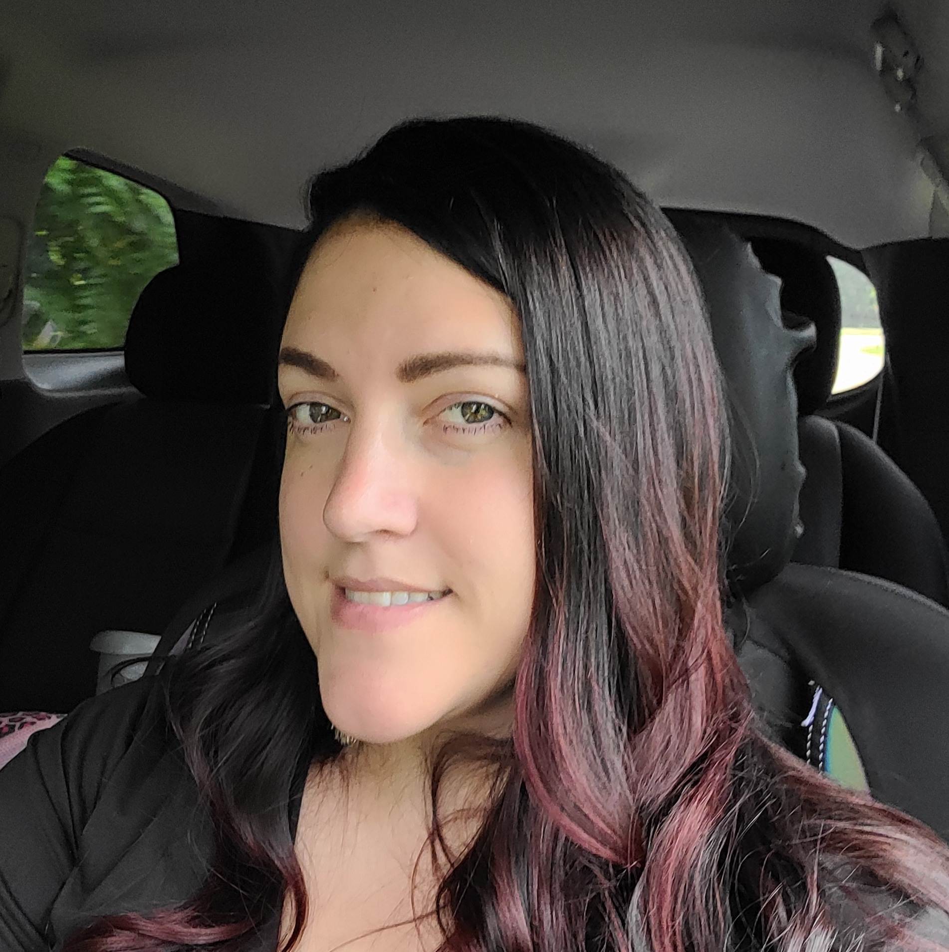
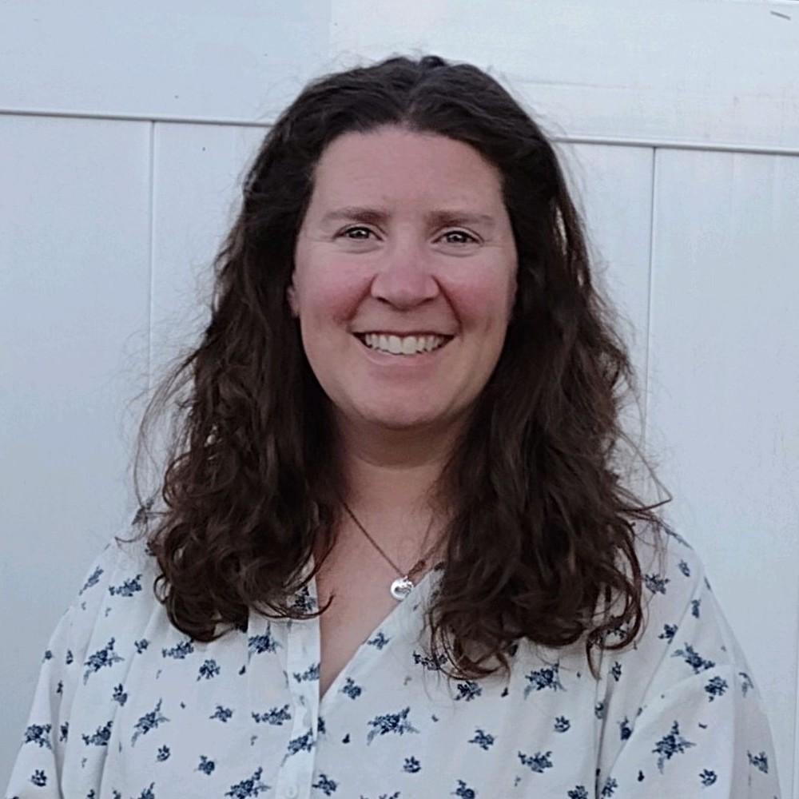
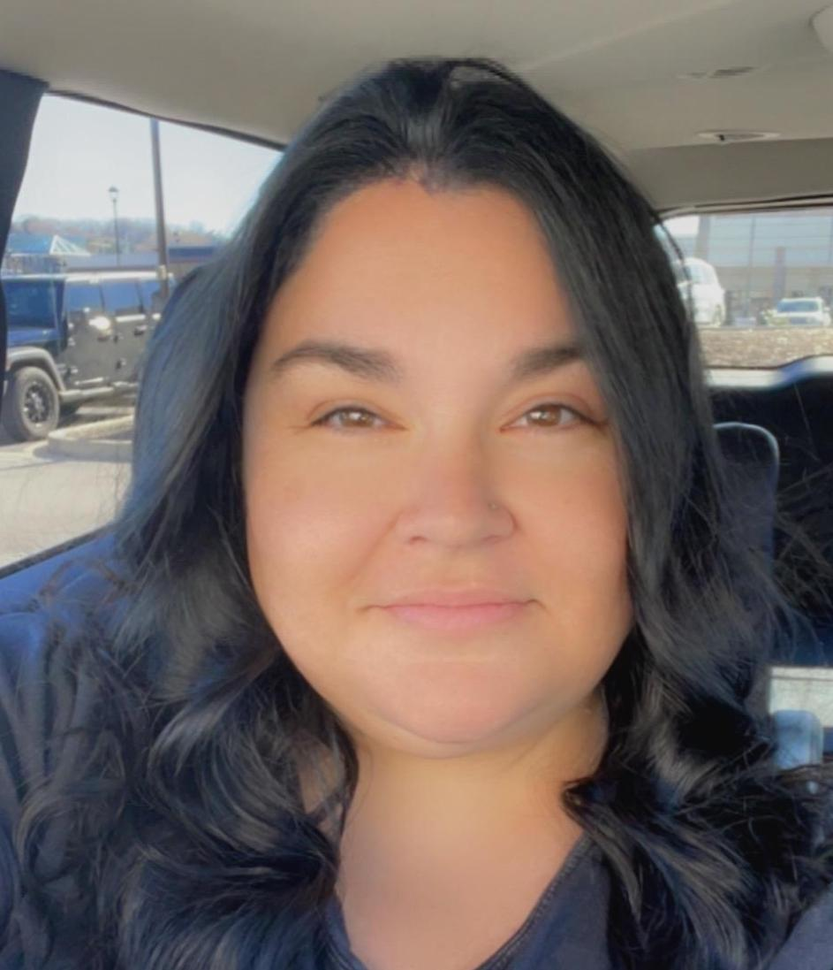
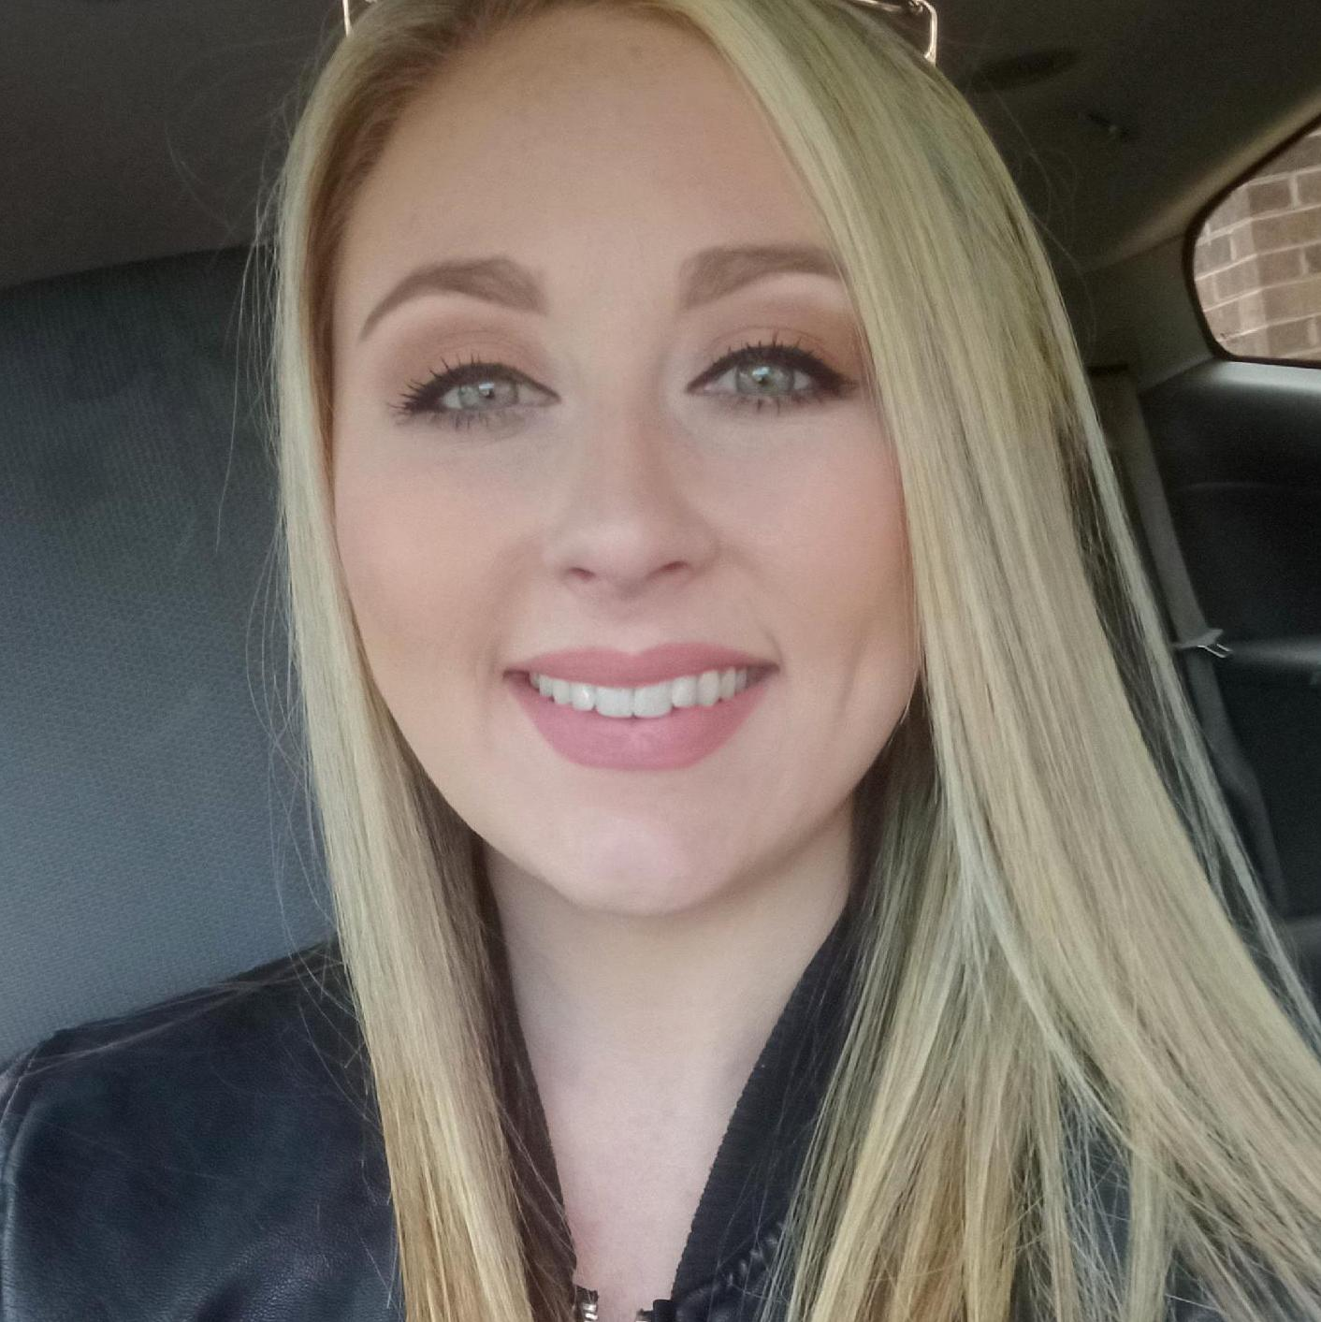
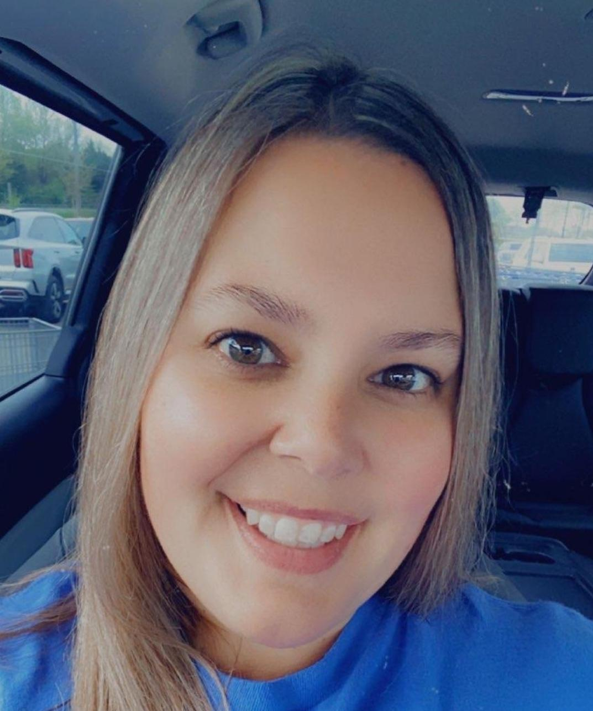
See any of our PTO Board Officers for more information….
President: Amber Lindsey
Vice President: Sarah Reynolds
Co-Vice President: Catelyn Henderson
Secretary: Christy Henson
Treasurer: Candace Adkins
Co-Treasurer: Shawn Parsons

